Slide 1
SIT374: Project Management
Lecture 11: More on agile and game-theoretic approach

Slide 2
Classification of SDLC models
Predictive (waterfall) model: The scope can be clearly articulated, and the time/cost can be accurately predicted.
Each phase is performed once
A large proportion of efforts would be spent to clarify requirements.
A working software may not be seen over an extended period of time.
Adaptive software development model (ASD): Software development follows an adaptive approach.
Iterative and incremental.
More freedom is allowed.
Applicable when requirements are subject to high level of uncertainty.
Agile software development model: Focus on close collaboration between programing team and business experts.

Slide 3
More on Agile
Agile in a nutshell
Iterative approach to Software Development
Builds a software incrementally
Accommodates changing business/customer needs
Incorporates frequent feedback
Feedback
Feedback

Slide 4
Waterfall vs agile
Waterfall
Agile
Liner Sequential Life Cycle Model
Upfront planning and in-depth documentation
Good for projects which has clear objectives
Project-focused
Close project manager involvement
Iterative method
Planning at each iteration
Good for projects with varying customer
requirements
Product and customer-focused
Small high-functioning team involvement

Slide 5
Agile Manifesto - Values
Individuals and interactions vs. processes and tools
Working software vs. comprehensive documentation
Customer collaboration vs. contract negotiation
Responding to change vs. following a plan
https://agilemanifesto.org

Slide 6
Agile Myths
Notes:
Anything goes
Time

Slide 7
Agile Methodologies
Agile Scrum Methodology.
Lean Software Development.
Kanban.
Extreme Programming (XP)
Crystal.
Dynamic Systems Development Method (DSDM)
Feature Driven Development (FDD)

Slide 8
Scrum Methodology
A way to restart the game after an interruption, where the forwards of each side
come together in a tight formation and struggle to gain possession of the ball when it is tossed
in among them.

Slide 9
Scrum as an Agile methodology
Empirical process
Iterative, incremental process
Team-based approach
Developing systems/ products with rapidly changing requirements
Controls the chaos of conflicting interest and needs
Improve communication and maximize cooperation
Protecting the team form disruptions and impediments
A way to maximize productivity

Slide 10
Scrum Framework

Slide 11
Components of Scrum
Scrum Artifacts
Scrum Process
Scrum Roles

Slide 12
Scrum Artifacts – User Stories
Captures product feature from user’s prospective
As a ______, I want _________, so that __________.
As an online shopper, I want a basket, so that I can put all the items I want to buy in to before finalising my purchase
As a business owner, I want the storage of my website to be customisable, so that I only pay for the storage amount I use
Feature are extracted from user stories
A basket needs to be implemented
Website needs to be hosted on the cloud

Slide 13
Scrum Artifacts: Product Backlog and Sprint Backlog
Like a to do list
Includes list of features and user stories to be implemented in a sprint
Populated by User Stories
Prioritised feature list
Features
Bugs
Technical work
Knowledge acquisition

Slide 14
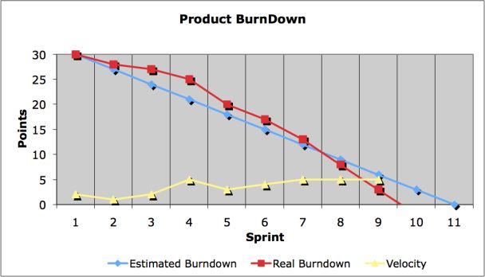
Scrum Artifacts: Burndown Charts

Slide 15
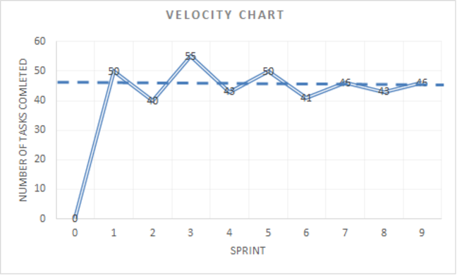
Scrum Artifacts: Velocity Charts
Allows squads to measure how many tasks they can do per iteration.
Prediction will be difficult in the beginning.
The squads gradually build a reliable estimation.
Should aim for steady state eventually.

Slide 16
Scrum Process: Sprint Planning
A collaborative meeting at the beginning of each Sprint
Sprint planning Part 1
Participants: Product Owner, Scrum Master, Scrum Team
Creating Product Backlog
Determining the Sprint Goal
Sprint planning Part 2
Participants: Scrum Master, Scrum Team
Creating Sprint Backlog

Slide 17
Scrum Process: Sprint
A month-long iteration, when product functionality is increased
NO outside influence can interference with the Scrum team during the Sprint
Each Sprint begins with the Daily Scrum Meeting

Slide 18
Scrum Process: Daily Scrum
Is a short meeting (15 mins)
Held every day before the team starts working
Participants: Scrum Master & Scrum Team
Team members should answer 3 questions
What did you do since the last Scrum?
What is stopping you getting on with the work?
What are you doing until the next Scrum?

Slide 19
Scrum Process: Sprint Review
Held at the end of each sprint
To show/demo what you have accomplished during the sprint
Assess project against the sprint goal

Slide 20
Scrum Process: Sprint Retrospective
Last thing done in each sprint
Entire team attends (Scrum team, scrum master, product owner)
Takes usually an hour (can go way longer)
A reflection on how things are going and find ways to improve

Slide 21
Scrum Roles: The Scrum Team
Typically 5-10 people
Cross-functional (QA, Programmers, UI Designers, etc.)
Members should be full-time
Team is self-organizing
Membership can change only between sprints

Slide 22
Scrum Roles: Product Owner
Represents business/customer/client
Provides the vision for the product
Prioritises items on agile product backlog
Describes top items to the team
Directs the team to the right goal

Slide 23
Scrum Roles: Scrum Master
Team coach
Help team members with Scrum process
Not a traditional project manager
Does not provide day to day directions to team
Does not (preferably) assign tasks to individuals
Helps team focus on the goal they have selected

Slide 24
Scrum Roles: Scrum Team
Team moves items from product backlog to sprints
Implements the features
There are no specific titles for individuals (tester, programmer, etc.)
Team members may go beyond their discipline

Slide 25
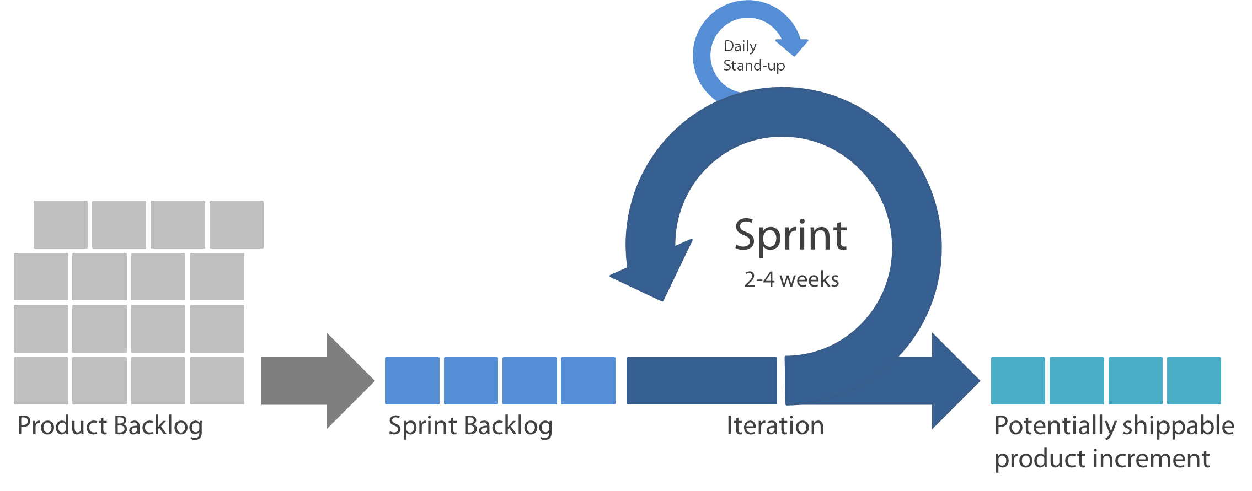
Scrum Summery

Slide 26
Game-theoretic approach…

Slide 27
What is a game?
A game is a situation in which multiple interactive parities (players) attempt to make rational decisions to optimize their respective objectives based on a set of rules and available information.
Everything is a game…
Poker, chess, soccer
Advertising, auctions, insurance
relations, trade agreements, electoral campaigns
attack-defense

Slide 28

An examples of game
Prisoner’s Dilemma
Two suspects arrested for a crime.
Prisoners decide whether to
confess or not to confess.
If both confess, both sentenced to 5 months of jail.
If both do not confess, then both will be sentenced to 2 month of jail.
If one confess and the other does not, then the confessor gets freed and the non-confessor sentenced to 9 months of jail.

Slide 29
What is game theory?
Game theory is a branch of applied mathematics that provides tools for analyzing interactive decision-making process, in which the payoff for each player depends on the actions of all.
When choosing one’s own course of action, the choices of others must be taken into account. Game theory provides a framework to predict others’ play and guide the formulation of optimal decisions/ actions.

Slide 30
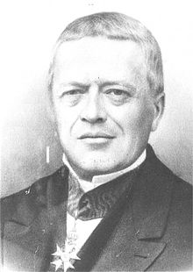
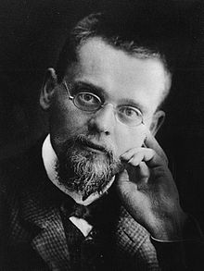
HISTORY OF GAME THEORY
Initial period
Cournot (1838): quantity setting duopoly
Zermelo (1913): backward induction
Cournot
Zermelo

Slide 31

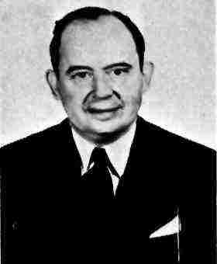
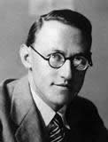

HISTORY OF GAME THEORY
Emergence
von Neumann (1928), Borel (1938), von Neumann and Morgenstern (1944): zero-sum games, formal emergence of game theory
Nash (1950): notion of Nash equilibrium
The book indicating the formal emergence of game theory
Von Neumann
Morgenstern
Nash

Slide 32
HISTORY OF GAME THEORY
Major development
Selten (1995): dynamic games
Harsanyi (1967): incomplete information
Akerlof (1970), Spence (1973): first applications
1980s boom, continuing nowadays: repeated game, stochastic game, differential game, equilibrium refinements, contract theory…
1990s: parallel development of behavioral economics

Slide 33
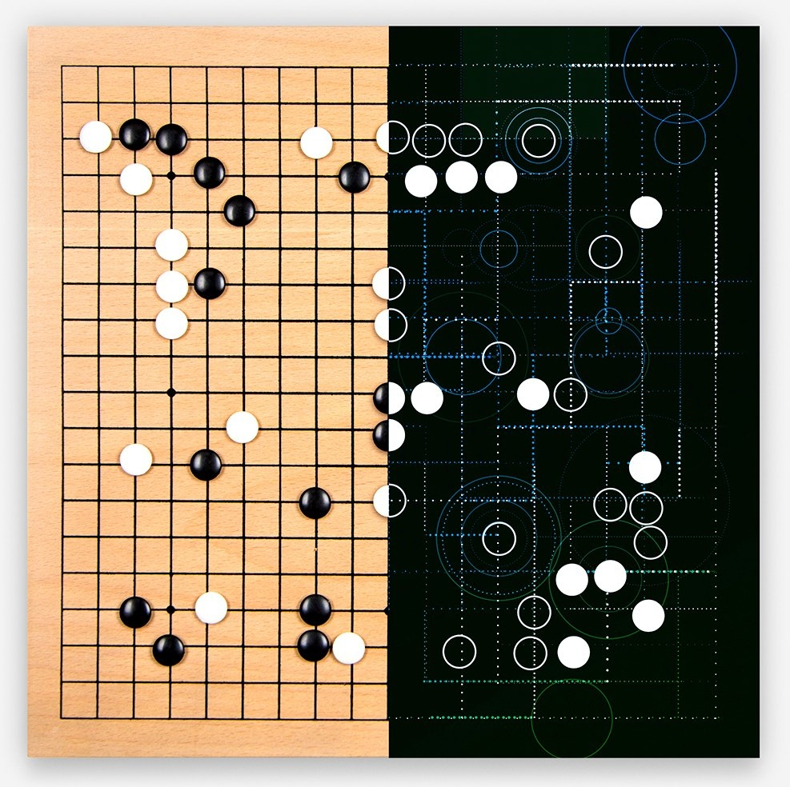

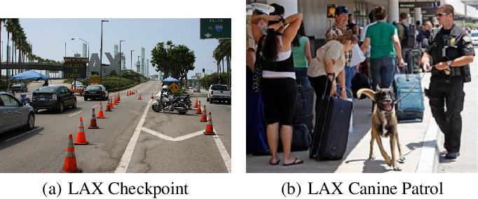
HISTORY OF GAME THEORY
Widespread applications
More recently: applications to computer science (AI, physical/cyber security), (project) management, political science, military strategy, sports, game playing, evolutionary biology…
Security resource deployment for airports
Fighting against cyberattacks
Playing Go game (AlphaGo)

Slide 34
Elements of a game
Players: Who is interacting?
Actions: What are moves of players at each decision point?
Strategies: What is the conduct plan for the course of actions?
Payoffs: How do strategies translate into outcomes? What are players’ preferences over possible outcomes?
Information: What do players know about the situation and about one another? What actions do they observe before making decisions?

Slide 35
classification of games
Game theory
Non-cooperative games
Cooperative games
Static games
Dynamic games
Complete information
Incomplete information
Complete & perfect information
Complete & imperfect information
Incomplete & perfect information
Incomplete & imperfect information
Both cooperative/non-cooperative games can be applied in
handling different scenarios in project management.

Slide 36
Goal of a game – equilibrium
Once a non-cooperative game is formulated. Now what?
We could ask: How to play the game or say, how to formulate optimal strategies for each player within this game?
Since the payoff of each player is jointly determined by the entire strategy profile (strategy combination of all players), the optimal solution concept is not well defined.
A satisfactory solution concept (equilibrium), which is acceptable to all players, must be introduced.

Slide 37
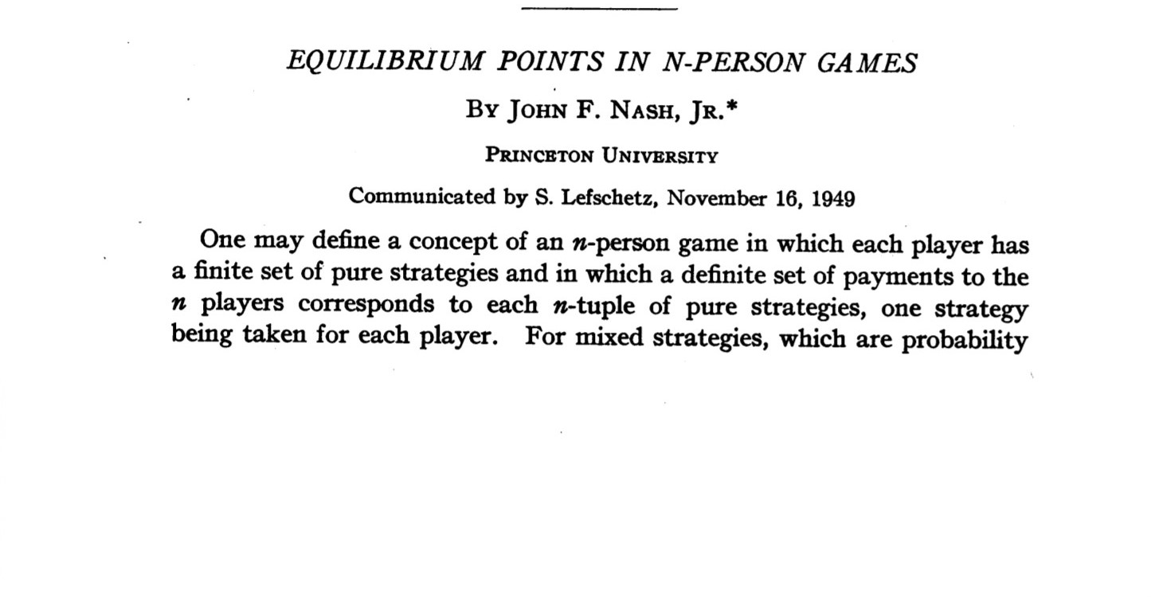
Nash equilibrium (NE)
A satisfactory solution concept of strategy profile where none of the players can improve his payoff by a unilateral move (have an incentive to deviate from).
For any player, once all other players stick to the strategies in the Nash equilibrium, his strategy in the Nash equilibrium is the optimal strategy to him.

Slide 38
GAME THEORY and project management
Stakeholder analysis
Stakeholder’s potential decisions and outcomes can be analyzed.
Align better the individual objectives with project goals.
Resource allocation
Limited resources (time, money and HR) need to be allocated efficiently.
Game theory can potentially facilitate efficient use of resources.
Conflict resolution
Game theory strategies such as Nash equilibrium can guide PMs in devising resolution strategies.
T. Narbaev, et al. “A review of the use of game theory in project management”, Journal of Management in Engineering,
vol. 38, no. 6, Art. No. 03122002, 2022.

Slide 39
An example
This example focuses on a software development project with two teams involved in a negotiation over resource allocation.
Team involved:
Frontend team: user interface and user experience
Backend team: server, application, database, network services
Source conflict: Both teams require additional software developers and computational resources to meet their deadlines. The project has a limited number of developers and a fixed budget for computational resources, leading to a conflict over how these should be distributed between the two teams.
Objective: Optimize resource allocation between the two teams.

Slide 40
An example – game model
Strategies:
Frontend Team: Can request either a high or low number of additional resources.
Backend Team: Can also choose between requesting a high or low number of additional resources.
Payoffs: Determined by the satisfaction level of each team based on the resources received, which impacts their ability to meet project deadlines.
Assumptions for NE Calculation:
Assume the payoff values range from 0 (lowest satisfaction) to 10 (highest satisfaction), If both teams request high resources, they each get only a part due to budget limits, resulting in medium satisfaction (5, 5). If one team requests high resources and the other low, the high request receives significantly more, leading to high satisfaction (8) for the high requester and low (2) for the low requester. If both request low resources, they receive slightly more than what they asked for, resulting in high satisfaction (7, 7) due to efficient use under budget constraints.

Slide 41
An example – Nash equilibrium
The Nash Equilibrium (NE) in this scenario would be for both teams to request low resources (Low/Low), resulting in (7,7) because changing any team’s strategy wouldn’t increase their payoff assuming rational decision-making and symmetrical information about the payoffs.

Slide 42
Roadmap for game-theoretic project management
Step 1: Identify a problem in certain scenarios (resource allocation, conflict resolution, etc.)
Step 2: Identify the players and formulate the strategies.
Step 3: Formulate the payoffs.
Step 4: Model the underlying problem as a game-theoretic problem.
Step 5: Develop (learning) algorithms to calculate (learn) equilibrium in the chosen solution concept.

Slide 43
summary
Agile methodology
Agile vs waterfall
Scrum framework
Scrum artifacts, processes, roles
Game-theoretic approach
Fundamentals of game theory
How game theory can be applied in project management

